Slide 1

ENTEROBACTERIACEAE
Dr Zainab Sabeeh Whrewesh
1

Slide 2
Enterobacteriaceae
Commonly present in large intestine
Some are non pathogenic
A few are highly Pathogenic,
Some commensals turn out to be pathogenic. as in UTI after catheterization.

Slide 3
Include: Escherichia coli, Salmonella, Shigella, Enterobacter, Klebsiella, Proteus and Serratia

Slide 4
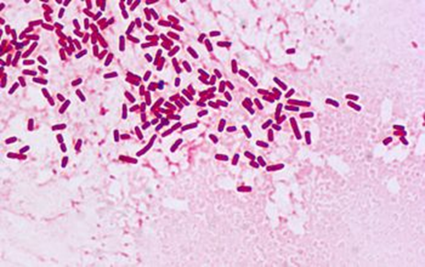
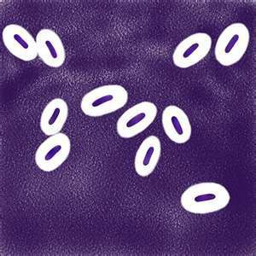
Characters of Enterobacteriaceae
All Enterobacteriaceae
  Gram-negative rods
  Ferment glucose with acid production
  Reduce nitrates into nitrites
  Oxidase negative (except Plesiomonas shigelloides)
  Catalase positive (except Shigella dysenteriae)
Facultative anaerobic
Motile except Shigella and Klebsiella
Non-capsulated except Klebsiella
Non-fastidious
Grow on bile containing media (MacConkey agar(

Slide 5
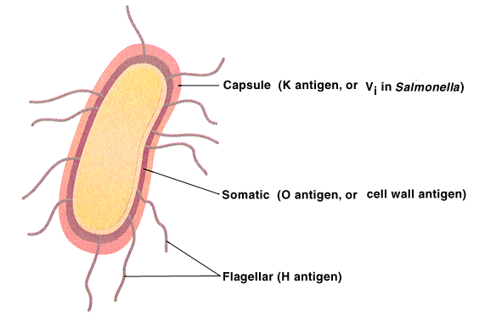
Classification:
1- Serological classification upon antigens:
*Somatic antigen (O-Ag)
*Flagellar antigen (H-Ag)
*Capsular antigen (K-Ag)
2- Biochemical reactions and sugar fermentation.
3- DNA-DNA hybridization and G:C ratio.

Slide 6
(TSI )Triple Sugar-Iron agar
Purpose
1- detect organisims that ferment different types of sugars
2- detect the bacteria that degrade amino acid and produce H₂S gas (H₂S gas will react with Fe and produce black precipitate between the slant and butt).
FeSO4 + H2S → FeS↓ + H2SO4
(Black ppt.)
The media used in this test contain
1- three sugars (0.1% glucose, 1.0 % lactose and sucrose)
2- peptone (protein has amino acid and sulfur)
3 –phenol red (as indicator sugar fermentation)

Slide 7
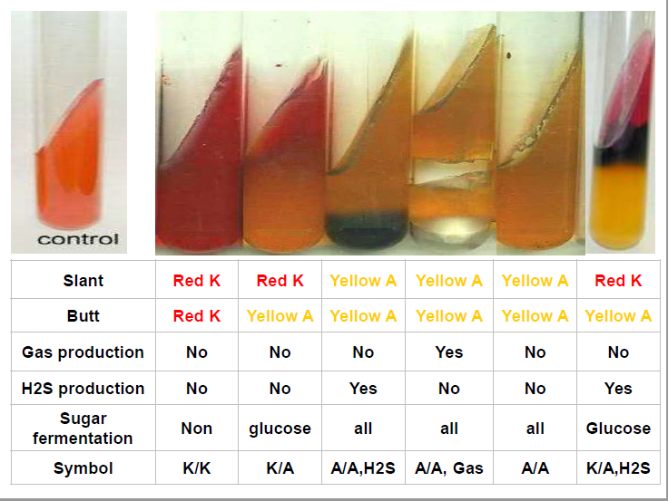
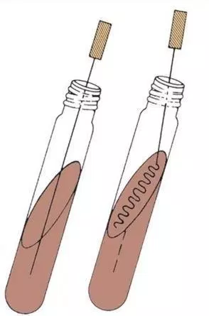
TSI agar :

Slide 8
IMViC test
Indole, Methyl Red, Voges-Prosakaur, Citrate Tests:
  The IMViC series of reactions allows for the differentiation of the various members of Enterobacteriaceae.

Slide 9
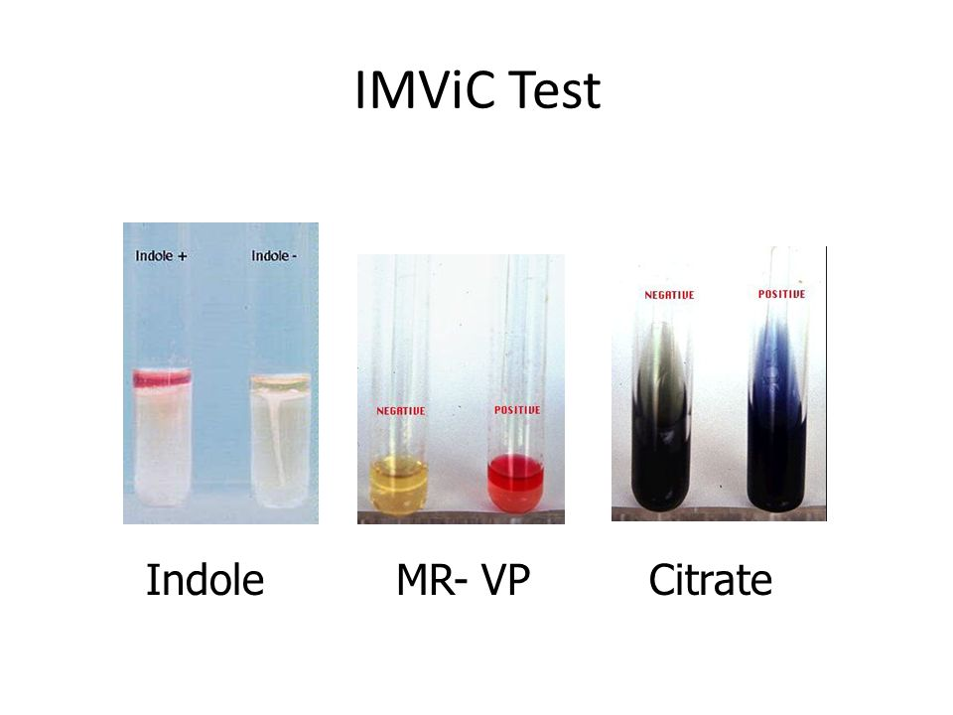

Slide 10
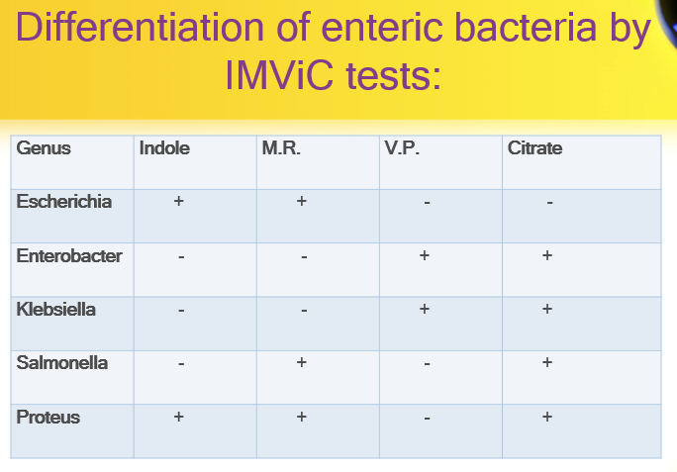

Slide 11
Indole test
Principle
  Certain microorganisms can metabolize tryptophan by tryptophanase
  The enzymatic degradation leads to the formation of pyruvic acid, indole and ammonia
  The presence of indole is detected by addition of Kovac's reagent.
Tryptophane
amino acids
Tryptophanase
Indole + Pyruvic acid + NH3
Kovac’s Reagent
Red color in upper organic layer`

Slide 12
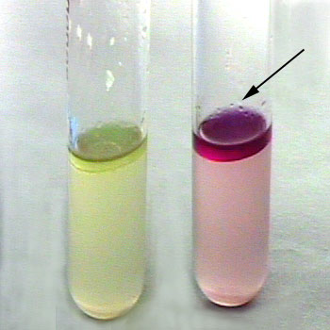
Negative test
e.g. Klebsiella
Positive test
e.g. E. coli

Slide 13
Methyl Red-Voges Proskauer (MR-VP) Tests
Principle
Glucose
Acidic pathway
Or
Neutral pathway
Acety methyl carbinol
(ACETOIN)
Mixed acids
⬇ pH less than 4.4
12 drops of solution A (α-naphthol)
4 drops of Solution B (40% KOH)
Methyl Red
indicator
MR positive
E. coli
VP positive
Klebsiella
Pink color
Red color

Slide 14
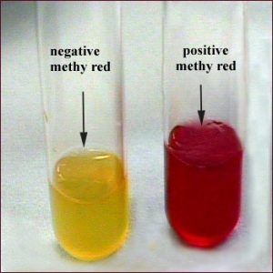
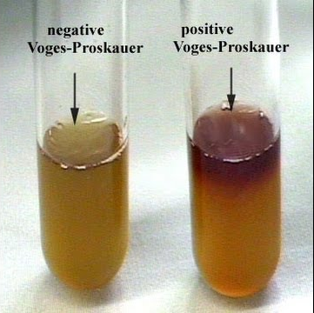
Methyl Red test
Voges-Proskauer test
Yellow or orange: Negative MR (Klebsiella)
No pink: Negative VP (E. coli)
  Red: Positive MR (E. coli)
Pink: Positive VP (Klebsiella)

Slide 15
Citrate Test
This is a defined medium used to determine if an organism can use citrate as its sole carbon source. It is often used to differentiate between members of Enterobacteriaceae. In organisms capable of utilizing citrate, the enzyme citrase hydrolyzes citrate into oxaoloacetic acid and acetic acid. If CO2 is produced, it reacts with components of the medium to produce an alkaline compound. The alkaline pH turns the pH indicator (bromthymol blue) from green to blue.

Slide 16
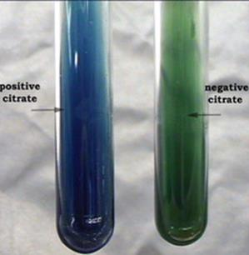
Citrate Utilization Test
Principle:
Citrate
Pyruvate
CO2 + Na + H2O
Na₂CO₃
Alkaline ↑pH
Simmone’s Citrate media
Contains Citrate as a sole of C source
Bromothymol blue
Positive test
Blue color
  Positive test: Klebsiella, Enterobacter, Citrobacter
Negative test: E. coli

Slide 17
Urease Test
This test is used to identify bacteria capable of hydrolyzing urea using the enzyme urease. The hydrolysis of urea forms the weak base, ammonia, as one of its products. This weak base raises the pH of the media above 8.4 and the pH indicator, phenol red, turns from yellow to pink. Urease Test. Proteus mirabilis is a rapid hydrolyzer of urea (center tube). The tube on the left was inoculated with a urease negative organism and the tube on the far right was uninoculated. Helicobacter pylori has urease activity that hydrolyse urea (making so a good environment– NH4 – for surviving in acidic environment - stomach)

Slide 18
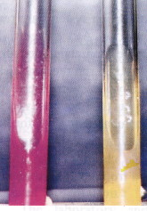
Urease Test
  Principle
Urea agar contains urea and phenol red
Urease is an enzyme that catalyzes the conversion of urea to CO2 and NH3
Ammonia combines with water to produce ammonium hydroxide, a strong base which ↑ pH of the medium.
↑ in the pH causes phenol red r to turn a deep pink. This is indicative of a positive reaction for urease
Positive test
Negative test
Urease
H2O
↑ in pH
Deep pink
Urea
CO2 + NH3
NH4 OH
Phenol Red

Slide 19
Motility Test
• Principle:
• Motility Test Media is a semi-solid agar designed to
demonstrate motility by diffusion.
• This is not a biochemical test, but it can distinguish bacteria. It determines presence of flagella.
– Positive test: Growth spread away from the line of
inoculation = motile
– Negative test: Growth only occurred at the line of
inoculation = Non-motile
• Significance: This test is used for the differentiation
of microorganisms on the basis of
motility.

Slide 20
Enterobacteriaceae
Proteus mirabilis on blood agar - for most strains of P. mirabilis and P. vulgaris is typical their ability to swarm (RAUSS phenomenon) over the surfaces of solid cultivation media (the spreading growth covers other organisms in the culture and thus delays their isolation).

Slide 21
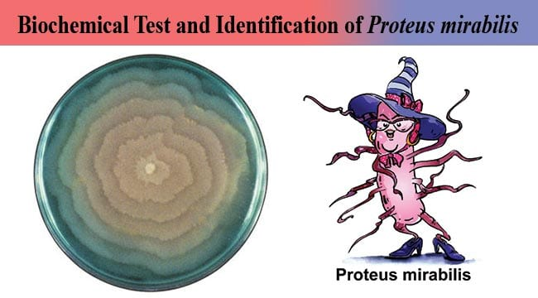
Enterobacteriaceae

Slide 22
Enterobacteriaceae
Oxidase •
Detects cytochrome oxidase enzyme that converts dimethylphenyldiamine to indophenol blue (clear to blue) • Oxidase +ve bacteria: – Pseudomonas – Vibrio Glucose fermentation

Slide 23
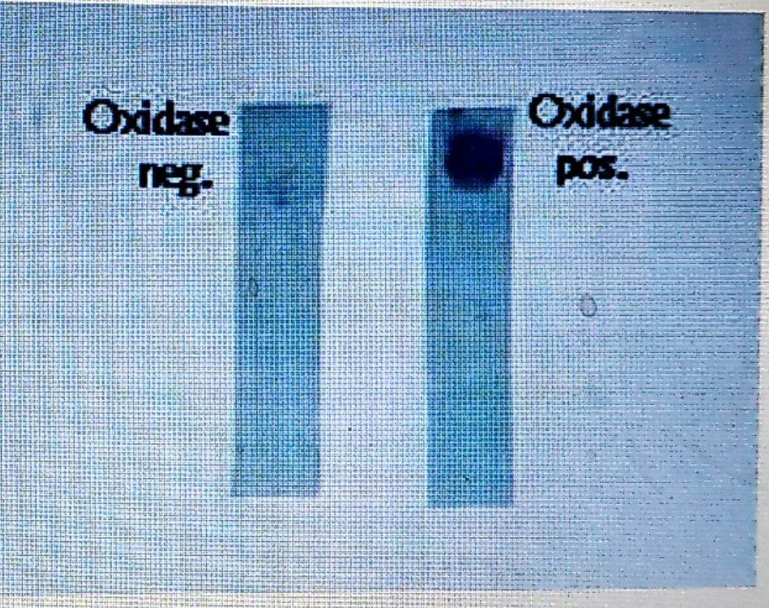

Slide 24
Enterobacteriaceae
Lactose fermentation
• Detects ability of bacteria to ferment lactose to glucose then to pyruvic acid.
• Detected by phenol red pH indicator (red/alkaline to yellow/acid)
• Bacteria that ferment glucose: – E.coli – Klebsiella

Slide 25
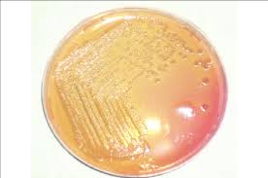
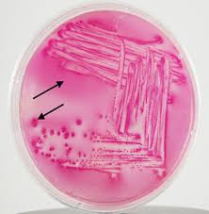
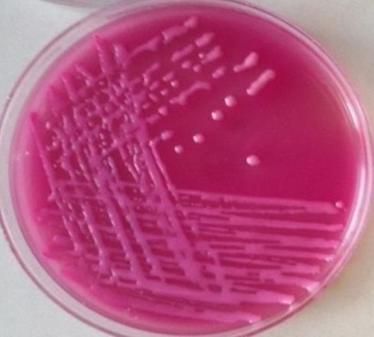
Lab. Diagnostic tests:
MacConkey agar:

Slide 26
Enterobacteriaceae
Nitrate
• Detects nitrate reductase enzyme which converts nitrate to nitrite.
• Nitrite then revealed by addition of naphthylamine and sulfinic acid to form diazonium dye (clear to red)
• Nitrate +ve bacteria: – E.coli – Klebsiella

Slide 27
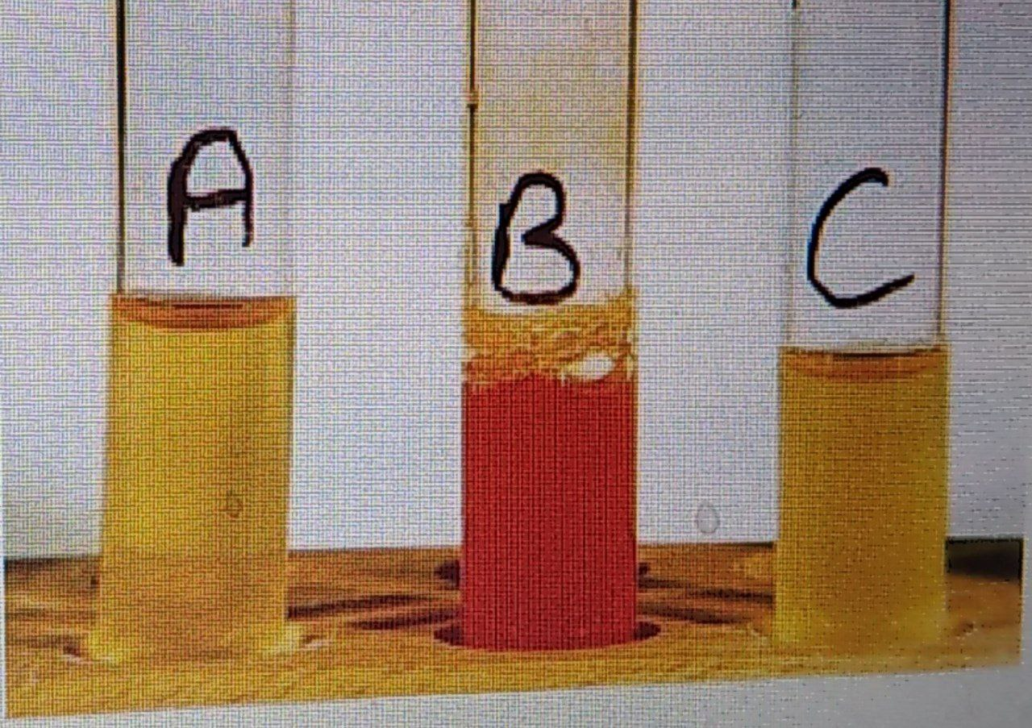

Slide 28
Enterobacteriaceae
API
• Minituarized biochemical reactions in >20
wells
• Takes 2-24 hrs
• Reaction profile (“biocode”) compared to an on-line database of >20000 isolates
• Commerical test

Slide 29
